Slide 1
Travel Explorer
“Good company on a journey makes the way seem shorter.”

Slide 2
Objective
Objective is to create a user-friendly website that connects travelers with compatible travel buddies, ensuring safety, facilitating trip planning, and fostering a strong travel community.
Facilitate the connection of like-minded travelers seeking companions for their journeys.

Slide 3
Tethnical Details
HTML:For creating the structure and content of web pages.
CSS:For styling the HTML elements to improve the visual appeal of the website

Slide 4
Pages of the website
Destination
Tours
Contact

Slide 5
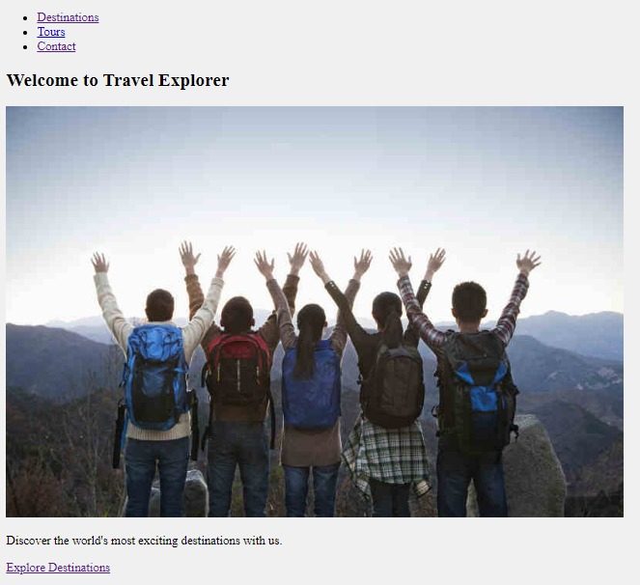
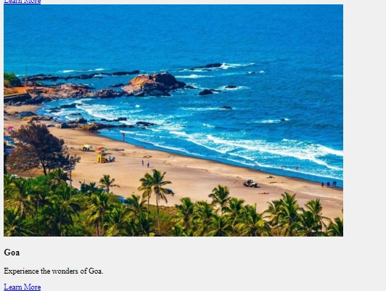
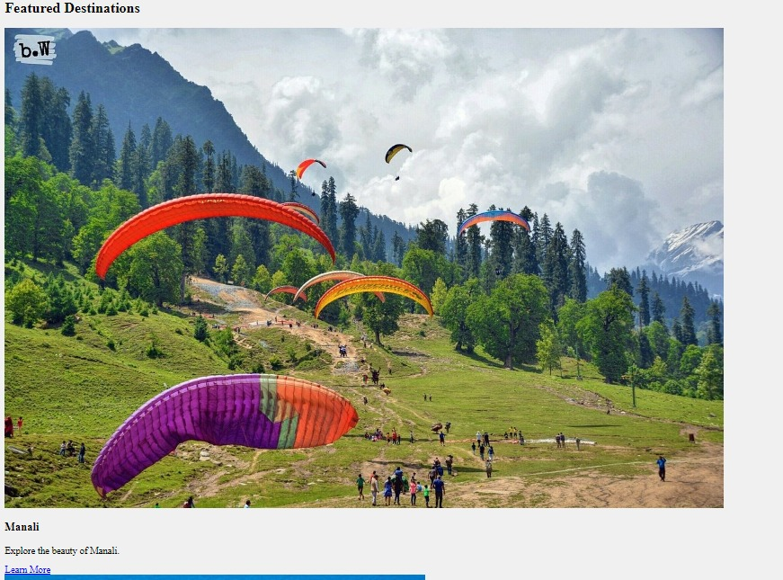
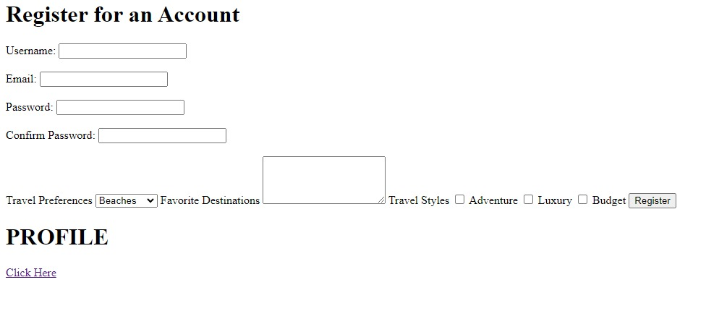
Website Pages

Slide 6
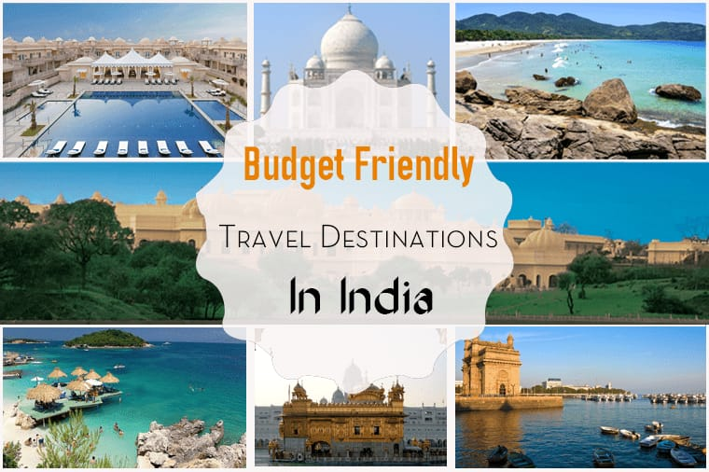
Conclusion
“Discover the world like never before with our comprehensive travel guides,expert recommendations,and exclusive deals.Let us be your ultimate companion in creating unforgettable journeys and remarkable experiences.Start your adventure today and let us help you create memories that last a lifetime.”

Slide 7


